Slide 1

Chapter 1
Introduction
A note on the use of these ppt slides:
We’re making these slides freely available to all (faculty, students, readers). They’re in PowerPoint form so you can add, modify, and delete slides (including this one) and slide content to suit your needs. They obviously represent a lot of work on our part. In return for use, we only ask the following:
If you use these slides (e.g., in a class) in substantially unaltered form, that you mention their source (after all, we’d like people to use our book!)
If you post any slides in substantially unaltered form on a www site, that you note that they are adapted from (or perhaps identical to) our slides, and note our copyright of this material.
Thanks and enjoy! JFK/KWR
All material copyright 1996-2009
J.F Kurose and K.W. Ross, All Rights Reserved
Computer Networking: A Top Down Approach ,
3rd/5th edition.
Jim Kurose, Keith Ross
Pearson/Addison-Wesley, April 2009.

Slide 2
Network Performance: Measurement & Evaluation

Slide 3
Motivations
Understanding network behavior
Improving protocols
Verifying correctness of implementation
Detecting faults
Monitor service level agreements
Choosing providers
Billing

Slide 4

How do loss and delay occur?
*packets queue in router buffers
-packet arrival rate to link exceeds output link capacity
-packets queue, wait for turn
-when packet arrives to full queue, packet is dropped (aka lost)
  -lost packet may be retransmitted by previous node, by source end system, or not retransmitted at all
packet being transmitted (delay)
A
B
packets queueing (delay)
free (available) buffers: arriving packets
dropped (loss) if no free buffers

Slide 5
Definitions
Link bandwidth (capacity): maximum rate (in bps) at which the sender can send data along the link
Propagation delay: time it takes the signal to travel from source to destination
Packet transmission time: time it takes the sender to transmit all bits of the packet
Queuing delay: time the packet need to wait before being transmitted because the queue was not empty when it arrived
Processing Time: time it takes a router/switch to process the packet header, manage memory, etc

Slide 6
Four sources of packet delay
1. nodal processing:
  check bit errors
  determine output link
2. queueing
  time waiting at output link for transmission
  depends on congestion level of router
transmission
A
propagation
B
nodal
processing
queueing

Slide 7
Delay in packet-switched networks
3. Transmission delay:
R=link bandwidth (bps)
L=packet length (bits)
time to send bits into link = L/R
4. Propagation delay:
d = length of physical link
s = propagation speed in medium (~2x10⁸ m/sec)
propagation delay = d/s
Note: s and R are very different quantities!
transmission
A
propagation
B
nodal
processing
queueing

Slide 8
Transmission delay
L
R
R
R
*Packet switching
  -Store-and-forward
  -Packet completely received before being transmitted to next node
*Takes L/R seconds to transmit (push out) packet of L bits on to link or R bps
*Entire packet must arrive at router before it can be transmitted on next link: store and forward
delay = 3L/R (assuming zero propagation delay)
Example:
L = 7.5 Mbits
R = 1.5 Mbps
delay = 15 sec
more on delay shortly …

Slide 9

Transmission vs Propagation Delay
Bandwidth: R bps
Propagation delay: T sec
R bits per second (bps)
T seconds
P bits
T
Transmission time = P/R
time
Propagation delay =T = Length/speed (per bit)

Slide 10
Transmission vs Propagation Delay
P = 1 Kbyte
R = 1 Gbps
100 Km, fiber =>
T = 500 usec
P/R = 8 usec
T >> P/R
T
P/R
time
T << P/R
P = 1 Kbyte
R = 100 Mbps
1 Km, fiber =>
T = 5 usec
P/R = 80 usec
T
P/R
time

Slide 11
Queueing Delay
The queue has Q bits when packet arrives packet has to wait for the queue to drain before being transmitted
Capacity = R bps
Propagation delay = T sec
P bits
Q bits
Queueing delay = Q/R
T
P/R
time

Slide 12

Queueing delay
R=link bandwidth (bps)
L=packet length (bits)
a=average packet arrival rate
traffic intensity = La/R
La/R ~ 0: average queueing delay small
La/R -> 1: delays become large
La/R > 1: more “work” arriving than can be serviced, average delay infinite!

Slide 13
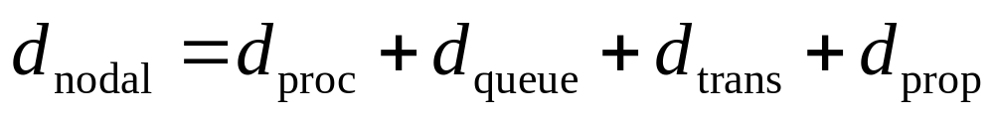
Nodal delay
d_{proc} = processing delay
  typically a few microsecs or less
d_{queue} = queuing delay
  depends on congestion
d_{trans} = transmission delay
  = L/R, significant for low-speed links
d_{prop} = propagation delay
  a few microsecs to hundreds of msecs

Slide 14
Delay Related Metrics
Delay (Latency) of bit (packet, file) from A to B
  The time required for bit (packet, file) to go from A to B
Jitter
  Variability in delay
Round-Trip Time (RTT)
  Two-way delay from sender to receiver and back
Bandwidth-Delay product
  Product of bandwidth and delay “storage” capacity of network

Slide 15
Little’s Theorem
Assume a system at which packets arrive at rate λ
Let d be mean delay of packet, i.e., mean time a packet spends in the system
Q: What is the mean (average) number of packets in the system (N) ?
d = mean delay
λ – mean arrival rate
system

Slide 16
Example
d = 5
λ = 1
d = 5
N = 5 packets
packets
0
1
2
3
4
5
6
7
8
9
10
11
12
13
14
15
16
time
A: N = λ x d
  E.g., N = λ x d = 5

Slide 17
“Real” Internet delays and routes
*What do “real” Internet delay & loss look like?
Traceroute program: provides delay measurement from source to router along end-end Internet path towards destination. For all i:
  -sends three packets that will reach router i on path towards destination
  -router i will return packets to sender
  -sender times interval between transmission and reply.
3 probes
3 probes
3 probes

Slide 18
Performance Metric: Throughput
Throughput of a connection or link = total number of bits successfully transmitted during some period [t, t + T) divided by T
Link utilization = (throughput of the link)/(link rate)
Bit rate units: 1Kbps = 10³bps, 1Mbps = 10⁶bps, 1 Gbps = 10⁹bps [For memory: 1 Kbyte = 2¹⁰ bytes = 1024 bytes]
  Some rates are expressed in packets per second (pps) -- relevant for routers/switches where the bottleneck is the header processing

Slide 19
Example: Windows Based Flow Control
Source
Destination
Connection:
  Send W bits (window size)
  Wait for ACKs
  Repeat
Assume the round-trip-time is RTT seconds
Throughput = W/RTT bps
Numerical example:
  W = 64 Kbytes
  RTT = 200 ms
  Throughput = W/RTT = 64,000*8/0.2s = 2.6 Mbps
RTT
RTT
RTT
time

Slide 20
Evaluation Techniques
Measurements
  gather data from a real network
  e.g., ping www.nyu.edu
  realistic, specific
Simulations: run a program that pretends to be a real network
  e.g., NS network simulator, Nachos OS simulator
Models, analysis
  write some equations from which we can derive conclusions
  general, may not be realistic
Usually use combination of methods

Slide 21
Simulation
Model of traffic
Model of routers, links
Simulation:
  Time driven:
X(t) = state at time t
X(t+1) = f(X(t), event at time t)
  Event driven:
E(n) = n-th event
Y(n) = state after event n
T(n) = time when even n occurs
[Y(n+1), T(n+1)] = g(Y(n), T(n), E(n))
Output analysis: estimates, confidence intervals

Slide 22
Simulation Example
Use trivial time-driven simulation to illustrate statistical multiplexing
Probabilistically generate the bandwidth of a flow, e.g.,
  With probability 0.2, bandwidth is 6
  With probability 0.8, bandwidth is 1
Average bandwidth, avg=0.2*6 + 0.8*1 = 2
peak/avg = 6/2 = 3

Slide 23
Statistical Multiplexing
As number of flows increases, agg_peak/agg_avg decreases
  For 1000 flows, peak/avg = 2125/2009=1.057
Q: What does this mean?
A: Multiplexing a large enough number of flows “eliminates” burstiness
  Use average bandwidth to provision capacity, instead of peak bandwidth
  E.g., For 1000 flows
    Average of aggregate bandwidth = 2,000
    Sum of bandwidth peaks = 6,000

Slide 24

Summary
Internet:
  User perspective: End-to-end view
  Network perspective: core-view
  Networking Technologies : Physical Media
Network Performance metrics

Slide 25
Network Design Principles

Slide 26
The Networking Dilemma
*Many different networking technologies
*Many different network applications
*How do you prevent incompatibilities?

Slide 27
Placing Network Functionality
*Hugely influential paper: “End-to-End Arguments in System Design” by Saltzer, Reed, and Clark (‘84)
*Basic observation: some types of network functionality can only be correctly implemented end-to-end
*Because of this, end hosts:
  -Can satisfy the requirement without network’s help
  Will/must do so, since can’t rely on network’s help
*Therefore don’t go out of your way to implement them in the network

Slide 28
Hourglass design
End-to-end principle leads to “Hourglass” design of protocols
Only one protocol at the Internet level
  Minimal required elements at narrowest point
IP – Internet Protocol
  http://www.rfc-editor.org/rfc/rfc791.txt
  http://www.rfc-editor.org/rfc/rfc1812.txt
  Unreliable datagram service
  Addressing and connectionless connectivity
  Fragmentation and assembly

Slide 29
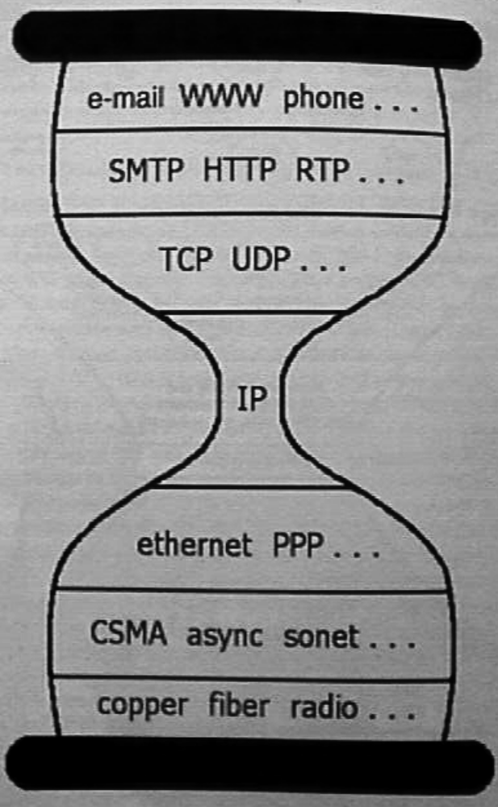
End-to-end principle and Hourglass design

Slide 30
End-to-end principle and the Hourglass design
The good
  Basic network functionality allowed for extremely quick adoption and deployment using simple devices
The bad
  New network features and functionality are impossible to deploy, requiring widespread adoption within the network
  IP Multicast, QoS

Slide 31
Network Architecture Principles

Slide 32
The Problem
Application
Skype
SSH
NFS
HTTP
Transmission
Media
Coaxial
cable
Fiber
optic
Radio
Re-implement every application for every technology?
No! But how does the Internet design avoid this?

Slide 33
Solution: Intermediate Layers
*Introduce intermediate layers that provide set of abstractions for various network functionality & technologies
  -A new app/media implemented only once
  Variation on “add another level of indirection”
Application
Skype
SSH
NFS
HTTP
Intermediate
layers
Transmission
Media
Coaxial
cable
Fiber
optic
Packet
radio

Slide 34
Network Architecture
*Architecture is not the implementation itself
*Architecture is how to organize/structure the elements of the system & their implementation
  -What interfaces are supported
    Using what sort of abstractions
  -Where functionality is implemented
  -The modular design of the network

Slide 35
Computer System Modularity
*Partition system into modules & abstractions:
*Well-defined interfaces give flexibility
Hides implementation - thus, it can be freely changed
Extend functionality of system by adding new modules
-E.g., libraries encapsulating set of functionality
-E.g., programming language + compiler abstracts away not only how the particular CPU works …
… but also the basic computational model

Slide 36
Network System Modularity
*Like software modularity, but:
*Implementation distributed across many machines (routers and hosts)
*Must decide:
  How to break system into modules
    Layering
  Where modules are implemented
    End-to-End Principle
  Where state is stored
    Fate-sharing -one's fate affects all

Slide 37
Example: Organization of air travel
ticket (purchase)
baggage (check)
gates (load)
runway takeoff
airplane routing
ticket (complain)
baggage (claim)
gates (unload)
runway landing
airplane routing
airplane routing
a series of steps

Slide 38

Layering of airline functionality
ticket (purchase)
baggage (check)
gates (load)
runway (takeoff)
airplane routing
ticket (complain)
baggage (claim
gates (unload)
runway (land)
airplane routing
ticket
baggage
gate
takeoff/landing
airplane routing
airplane routing
airplane routing
departure
airport
intermediate air-traffic
control centers
arrival
airport
Layers: each layer implements a service
  via its own internal-layer actions
  relying on services provided by layer below

Slide 39
Why layering?
Dealing with complex systems:
explicit structure allows identification, relationship of complex system’s pieces
  layered reference model for discussion
modularization eases maintenance, updating of system
  change of implementation of layer’s service transparent to rest of system
  e.g., change in gate procedure doesn’t affect rest of system
layering considered harmful?

Slide 40
Layering: A Modular Approach
*Partition the system
  -Each layer solely relies on services from layer below
  -Each layer solely exports services to layer above
*Interface between layers defines interaction
  -Hides implementation details
  -Layers can change without disturbing other layers

Slide 41
Layering in Networks: OSI Model
Physical
  how to transmit bits
Data link
  how to transmit frames
Network
  how to route packets host-to-host
Transport
  how to send packets end2end
Session
  how to tie flows together
Presentation
  byte ordering, formatting
Application: everything else
Application
Presentation
Session
Transport
Network
Data Link
Physical
Host

Slide 42
Properties of Layers (OSI Model)
*Service: what a layer does
*Service interface: how to access the service
  Interface for layer above
*Protocol (peer interface): how peers communicate to achieve the service
  -Set of rules and formats that govern the communication between network elements
  -Does not govern the implementation on a single machine, but how the layer is implemented between machines

Slide 43
Internet Protocol Stack
Only 5 layers!
--Application
--Transport
--Network
--Data Link
--Physical Layer

Slide 44
Physical Layer (1)
*Service: move bits between two systems connected by a single physical link
*Interface: specifies how to send and receive bits
  -E.g., require quantities and timing
*Protocols: coding scheme used to represent bits, voltage levels, duration of a bit

Slide 45
(Data) Link Layer (2)
*Service:
  -Enable end hosts to exchange atomic messages with one another
    Using abstract addresses (i.e., not just direct physical connections)
  -Perhaps over multiple physical links
    But using the same framing (headers/trailers)
  -Possible other services:
    arbitrate access to common physical media
    reliable transmission, flow control
*Interface: send messages (frames) to other end hosts; receive messages addressed to end host
*Protocols: addressing, routing, Media Access Control (MAC) (e.g., CSMA/CD - Carrier Sense Multiple Access / Collision Detection)

Slide 46
(Inter) Network Layer (3)
*Service:
  -Deliver packets to specified inter-network destination
    Inter-network = across multiple layer-2 networks
  -Works across networking technologies (e.g., Ethernet + 802.11 + Frame Relay + ATM …)
    No longer the same framing all the way
  -Possible other services:
    packet scheduling/priority
    buffer management
*Interface: send packets to specified internetwork destinations; receive packets destined for end host
*Protocols: define inter-network addresses (globally unique); construct routing tables

Slide 47
Transport Layer (4)
*Service:
  -Provide end-to-end communication between processes
  -Demultiplexing of communication between hosts
  -Possible other services:
    Reliability in the presence of errors
    Timing properties
    Rate adaption (flow-control, congestion control)
*Interface: send message to specific process at given destination; local process receives messages sent to it
*Protocol: perhaps implement reliability, flow control, packetization of large messages, framing
-Examples: TCP and UDP

Slide 48
Application Layer (7)
*Service: any service provided to the end user
*Interface: depends on the application
*Protocol: depends on the application
-Examples: Skype, SMTP (email), HTTP (Web), Halo, BitTorrent …
What happened to layers 5 & 6?
  “Session” and “Presentation” layers
  Part of OSI architecture, but not Internet architecture

Slide 49
Drawbacks of Layering
*Layer N may duplicate lower level functionality
  -E.g., error recovery to retransmit lost data
*Layers may need same information
  -E.g., timestamps, maximum transmission unit size
*Layering can hurt performance
  -E.g., hiding details about what is really going on
*Some layers are not always cleanly separated
  -Inter-layer dependencies for performance reasons
  Some dependencies in standards (header checksums)
*Headers start to get really big
  -Sometimes header bytes >> actual content

Slide 50
Layer Violations
*Sometimes the gains from not respecting layer boundaries are too great to resist
*Can occur with higher-layer entity inspecting lower-layer information:
  -E.g., TCP-over-wireless system that monitors wireless link-layer information to try to determine whether packet loss due to congestion or corruption
*Can occur with lower-layer entity inspecting higher-layer information
  -E.g., firewalls, NATs (network address translators), “transparent proxies”
*Just as with in-line assembly code, can be messy and paint yourself into a corner (you know too much)

Slide 51
Who Does What?
*Five layers
  -Lower three layers implemented everywhere
  -Top two layers implemented only at hosts
Application
Application
Transport
Transport
Network
Network
Network
Datalink
Datalink
Datalink
Physical
Physical
Physical
Host A
Router
Host B

Slide 52
Logical Communication
Layers interacts with peer’s corresponding layer
Application
Application
Transport
Transport
Network
Network
Network
Datalink
Datalink
Datalink
Physical
Physical
Physical
Host A
Router
Host B

Slide 53
Physical Communication
*Communication goes down to physical network
*Then from network peer to peer
*Then up to relevant layer
Application
Application
Transport
Transport
Network
Network
Network
Datalink
Datalink
Datalink
Physical
Physical
Physical
Host A
Router
Host B

Slide 54
IP Suite: End Hosts vs. Routers
host
host
HTTP message
HTTP
HTTP
TCP segment
TCP
TCP
router
router
IP
IP packet
IP packet
IP packet
IP
IP
IP
Ethernet
interface
Ethernet
interface
SONET
interface
SONET
interface
Ethernet
interface
Ethernet
interface

Slide 55

Layer Encapsulation
User A
User B
Appl: Get index.html
Trans: Connection ID
Net: Source/Dest
Link: Src/Dest
Common case: 20 bytes TCP header + 20 bytes IP header
+ 14 bytes Ethernet header = 54 bytes overhead

Slide 56
Encapsulation
source
message
M
application
transport
network
link
physical
segment
H_{t}
M
datagram
H_{n}
H_{t}
M
frame
H_{l}
H_{n}
H_{t}
M
H_{l}
H_{n}
H_{t}
M
link
physical
H_{l}
H_{n}
H_{t}
M
switch
destination
H_{n}
H_{t}
M
network
link
physical
H_{n}
H_{t}
M
M
application
transport
network
link
physical
H_{l}
H_{n}
H_{t}
M
H_{l}
H_{n}
H_{t}
M
H_{t}
M
H_{n}
H_{t}
M
H_{l}
H_{n}
H_{t}
M
router

Slide 57
Discussion: Reliable File Transfer
Host A
Host B
Appl.
Appl.
OS
OS
OK
Solution 1: make each step reliable, and then concatenate them
Solution 2: end-to-end check and try again if necessary

Slide 58
Discussion
*Solution 1 is incomplete
  -What happens if any network element misbehaves?
  Receiver has to do the check anyway!
*Solution 2 is complete
  -Full functionality can be entirely implemented at application layer with no need for reliability from lower layers
*Is there any need to implement reliability at lower layers?
  -Well, it could be more efficient

Slide 59
Network Security
The field of network security is about:
  how bad guys can attack computer networks
  how we can defend networks against attacks
  how to design architectures that are immune to attacks
Internet not originally designed with (much) security in mind
  original vision: “a group of mutually trusting users attached to a transparent network” ☺
  Internet protocol designers playing “catch-up”
  Security considerations in all layers!

Slide 60
Bad guys can put malware into hosts via Internet
Malware can get in host from a virus, worm, or trojan horse.
Spyware malware can record keystrokes, web sites visited, upload info to collection site.
Infected host can be enrolled in a botnet, used for spam and DDoS attacks.
Malware is often self-replicating: from an infected host, seeks entry into other hosts

Slide 61
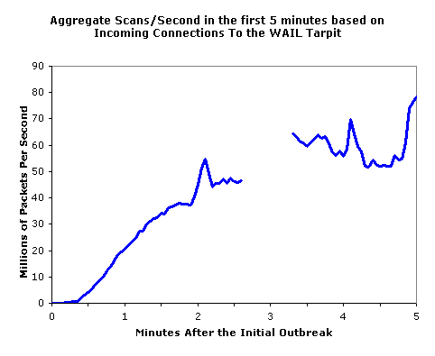
Bad guys can put malware into hosts via Internet
Trojan horse
  Hidden part of some otherwise useful software
  Today often on a Web page (Active-X, plugin)
Virus
  infection by receiving object (e.g., e-mail attachment), actively executing
  self-replicating: propagate itself to other hosts, users
Worm:
  infection by passively receiving object that gets itself executed
  self- replicating: propagates to other hosts, users
Sapphire Worm: aggregate scans/sec
in first 5 minutes of outbreak (CAIDA, UWisc data)
Introduction

Slide 62

Bad guys can attack servers and network infrastructure
Denial of service (DoS): attackers make resources (server, bandwidth) unavailable to legitimate traffic by overwhelming resource with bogus traffic
select target
break into hosts around the network (see botnet)
send packets toward target from compromised hosts
target

Slide 63
The bad guys can sniff packets
Packet sniffing:
  broadcast media (shared Ethernet, wireless)
  promiscuous network interface reads/records all packets (e.g., including passwords!) passing by
A
C
src:B dest:A payload
B
  Wireshark software used for end-of-chapter labs is a (free) packet-sniffer

Slide 64
The bad guys can use false source addresses
IP spoofing: send packet with false source address
A
C
src:B dest:A payload
B

Slide 65

The bad guys can record and playback
record-and-playback: sniff sensitive info (e.g., password), and use later
  password holder is that user from system point of view
C
A
src:B dest:A user: B; password: foo
B

Slide 66

Internet History
1961-1972: Early packet-switching principles
1961: Kleinrock - queueing theory shows effectiveness of packet-switching
1964: Baran - packet-switching in military nets
1967: ARPAnet conceived by Advanced Research Projects Agency
1969: first ARPAnet node operational
1972:
  ARPAnet public demonstration
  NCP (Network Control Protocol) first host-host protocol
  first e-mail program
  ARPAnet has 15 nodes

Slide 67
Internet History
1972-1980: Internetworking, new and proprietary nets
1970: ALOHAnet satellite network in Hawaii
1974: Cerf and Kahn - architecture for interconnecting networks
1976: Ethernet at Xerox PARC
ate70’s: proprietary architectures: DECnet, SNA, XNA
late 70’s: switching fixed length packets (ATM precursor)
1979: ARPAnet has 200 nodes
Cerf and Kahn’s internetworking principles:
  minimalism, autonomy - no internal changes required to interconnect networks
  best effort service model
  stateless routers
  decentralized control
define today’s Internet architecture

Slide 68
Internet History
1980-1990: new protocols, a proliferation of networks
1983: deployment of TCP/IP
1982: smtp e-mail protocol defined
1983: DNS defined for name-to-IP-address translation
1985: ftp protocol defined
1988: TCP congestion control
new national networks: Csnet, BITnet, NSFnet, Minitel
100,000 hosts connected to confederation of networks

Slide 69
Internet History
1990, 2000’s: commercialization, the Web, new apps
Early 1990’s: ARPAnet decommissioned
1991: NSF lifts restrictions on commercial use of NSFnet (decommissioned, 1995)
early 1990s: Web
  hypertext [Bush 1945, Nelson 1960’s]
  HTML, HTTP: Berners-Lee
  1994: Mosaic, later Netscape
  late 1990’s: commercialization of the Web
Late 1990’s – 2000’s:
more killer apps: instant messaging, P2P file sharing
network security to forefront
est. 50 million host, 100 million+ users
backbone links running at Gbps

Slide 70
Internet History
2010:
~500 million hosts
Voice, Video over IP
P2P applications: BitTorrent (file sharing) Skype (VoIP), PPLive (video)
more applications: YouTube, gaming
wireless, mobility

Slide 71
Summary
Network Performance Metrics & Evaluation
  Delay and Related metrics
Network Design Philosophy
  Case Study: Internet's Layered Architecture
  Network Security
  History of Internet

Slide 72
Acknowledgment & Copyright
Acknowledgment: The instructor duly acknowledges the authors of the text book “Computer Networking: A Top-down approach”, James Kurose & Keith Ross and the instructors of EE122 “Computer Networks” course at UC Berkeley, Ian Stoica, Scott Shenker, Jennifer Rexford, Vern Paxson and other instructors at Princeton University for the course material.
Copyright: Certain modifications have been done to adapt the slides to the current audience and copyrighted by the instructor -Bruhadeshwar (Instructor) Computer Networks 2013 Spring (C)

